Slide 1

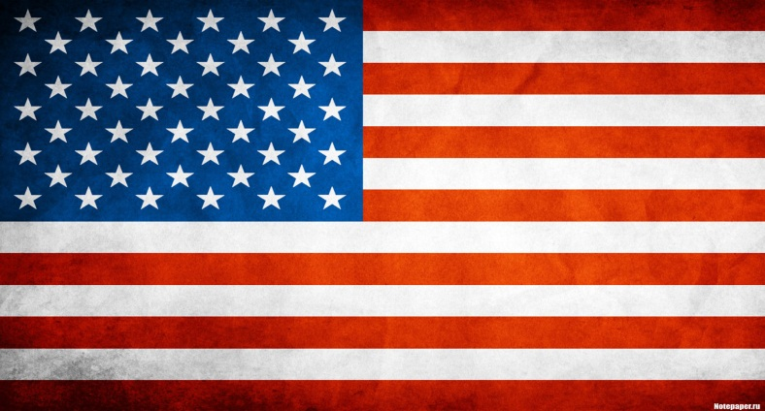
BRITISH ENGLISH
VS.
AMERICAN ENGLISH

Slide 2
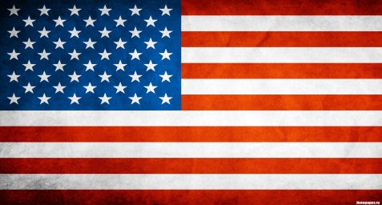
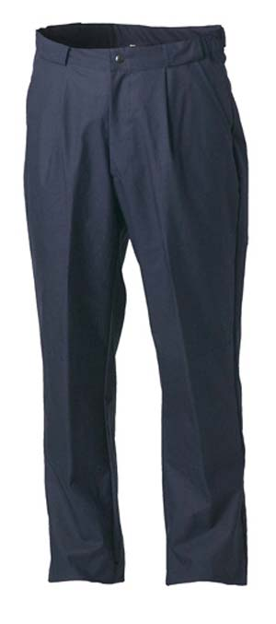
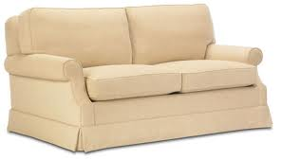
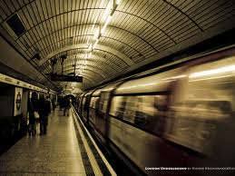

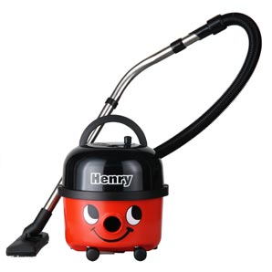
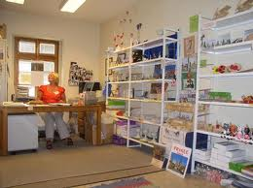
TROUSERS
PANTS
SOFA
COUCH
UNDERGROUND
SUBWAY
APARTMENT
FLAT
HOOVER
VACUUM CLEANER
STORE
SHOP

Slide 3
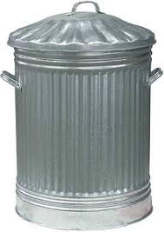
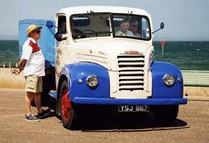
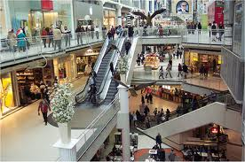


DUSTBIN
TRASH CAN
LORRY
TRUCK
SHOPPING
CENTRE
MALL
ANGRY
MAD
AUTUMN
FALL

Slide 4
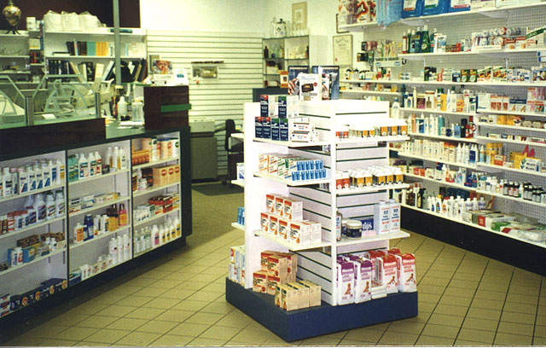
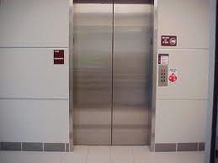
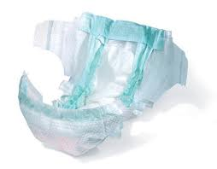
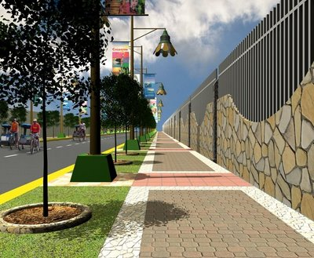
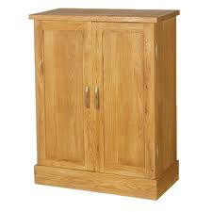
CHEMIST’S
DRUG STORE
LIFT
ELEVATOR
NAPPY
DIAPER
PAVEMENT
SIDEWALK
CUPBOARD
CLOSET

Slide 5
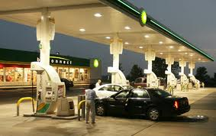
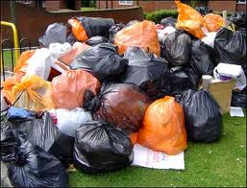
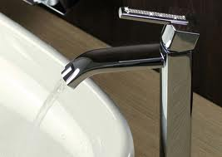
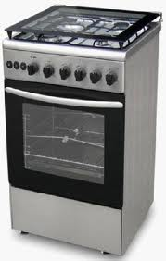
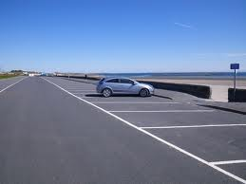
PETROL STATION
GAS STATION
RUBBISH
TRASH
TAP
FAUCET
COOKER
STOVE
CAR PARK
PARKING LOT

Slide 6
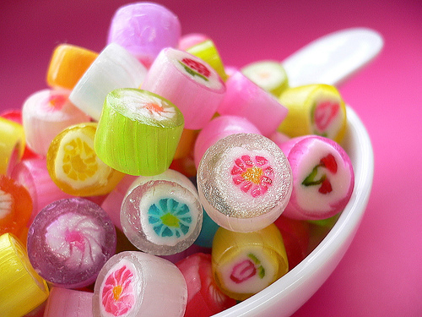
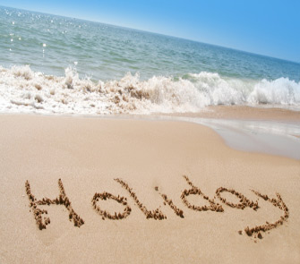
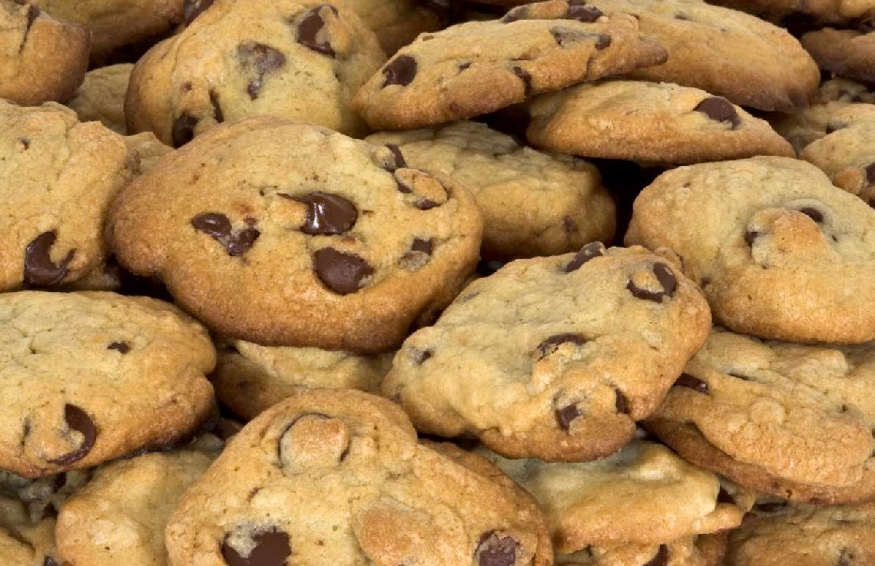

CANDIES
SWEETS
BISCUITS
COOKIES
DINNER
JACKET
TUXEDO
LET’S GO ON…
LET’S GO ON…
HOLIDAY!
VACATION!

Slide 7


SPELLING
There are also a number of different spelling rules between British English and American English.
1. Some words that end in ‘-tre’ in British English end in ‘-ter’ in American English.
US theater, center
Brit. theatre, centre
2. Some words that end in ‘-our’ in British English end in ‘-or’ in American English.
US color, labor
Brit. colour, labour
3. Some words are shorter in American English than in British English.
US catalog, program
Brit. catalogue, programme

