Slide 1
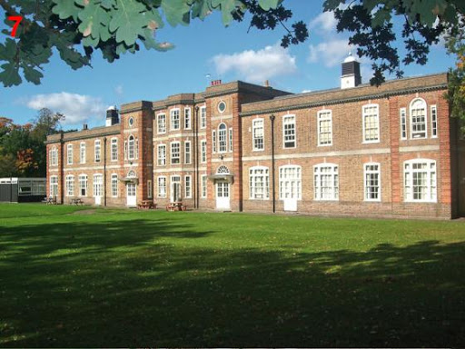
Today I would like to give you 7 reasons why it be nice to go to an Englisch school.

Slide 2
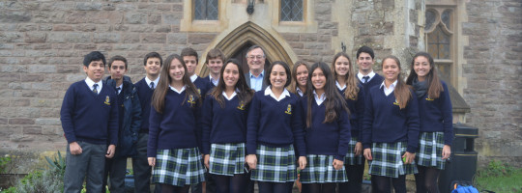
The first reason is:
Uniforms
The UK school, and especially
the William School, places great emphasis on the neat appearance of the students. Children wear uniforms every day. They have shirts and ties, long pants in fall and winter, short pants in spring and summer. No jewelry (except the watch) is allowed

Slide 3
The second reason is:
Backpack
This is not a heavy backpack, but a light, flat briefcase that holds an exercise book and a book, and a library book once a week.

Slide 4
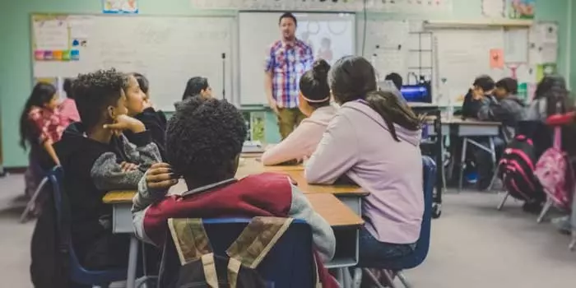
The third reason is:
Teachers
They take children very seriously, they are cute to them and always smiling. On the very first day, all teachers will know the children in their class by name.

Slide 5
And the fourth reason is:
Headmaster
I heard that in one school the headmaster is the wildly charismatic Paul Kinsella. Sometimes he drops by for class or lunch at the cafeteria. He can be found on the playground when the children are released home. He is at all performances and events important for children, in which he is very involved. During the adaptation days, the children could also sit in his office and spin on the swivel chair.

Slide 6
The fifth reason is:
After each semester, there is an interview (about 20 minutes of a 1: 1 meeting, for a specific hour) and an interview, where on the scale is your child in terms of learning progress, what is great and what you need to work on.

Slide 7
The sixth reason is:
Children may bring a water bottle to school. There can only be pure, still water in the water bottle. As a snack in class, children get vegetables and fruit, for which we pay 20p (PLN 1) a day. He can eat lunch at school or bring his healthy lunch. The youngest children get hot lunches for free.

Slide 8
The last reason why is:
The last bell on the Thames sounded much later than
on the Vistula, this year on July 21.
It's a fact, we prefer long holidays in Poland. But there are many more such short holidays in British schools.

Slide 9
Thank You very much for your time <3

