Slide 1
We invite you to watch our presentation☺
Zapraszamy do obejrzenia
Karolina Rudy, Piotr Rudy☺

Slide 2
English Polish
Student

Slide 3
English Polish
Hit -uderzenie
Hit

Slide 4
English Polish
Koala

Slide 5
English Polish
Radio

Slide 6
English Polish
Komputer - computer

Slide 7
English Polish
Zebra

Slide 8
English Polish
Zero
0

Slide 9
English Polish
Balloon

Slide 10
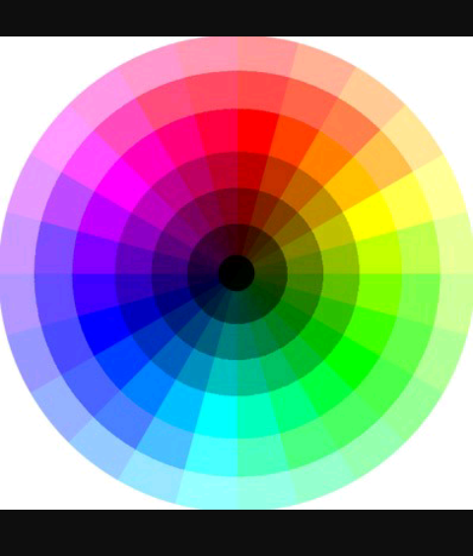
English Polish
Colour - kolor

Slide 11
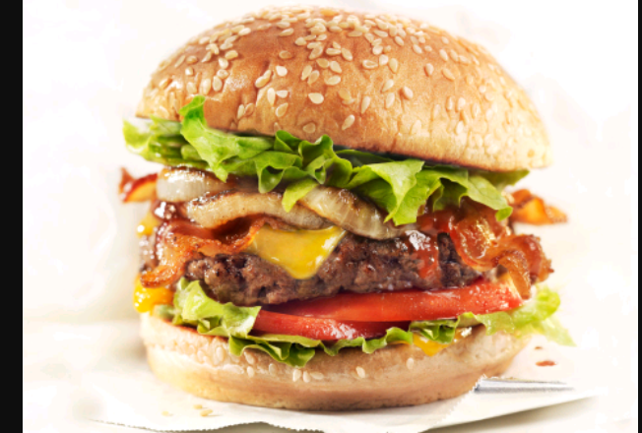
English Polish
Hamburger

Slide 12
English Polish
Yoghurt - jogurt

Slide 13
English Polish
Fact
Fakt, racja

Slide 14
English Polish
Kangaroo - kangur

Slide 15
Thanks you for your attention☺
Dziękujemy za uwagę☺

