Slide 1
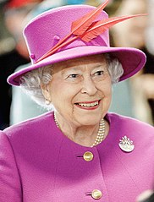
Queen Elizabeth the Second

Slide 2
Childhood
Elizabeth Alexandra Mary Windsor was born in Bruton Street 17 in Mayfair, London on April 21, 1926.
Her father was the Prince of York Albert, later King George VI. Her mother was Elizabeth Bowes-Lyon, daughter of Claude Bowes-Lyon, 14th Earl of Strathmore and Kinghorne.
When Elizabeth was 10 years old, her grandfather, King George V, died.

Slide 3
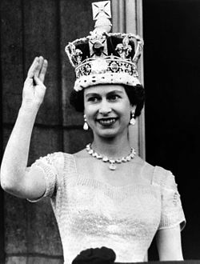
Coronation
On March 24, 1953, Maria Teck, the queen-widow, died of throat cancer, but before her death she expressed the wish that coronations would not be translated.
The Queen Elizabeth II repeated every gesture for a long time, she got used to wearing a crown, holding it on her head during breakfast, and walked the palace corridors with sheets attached to the shoulders. On the day of the coronation she was quite relaxed.

Slide 4
Travels
Queen Elizabeth has traveled extensively. In the years 1953-1954, she and her husband set out on a 6-month journey around the world, being the first monarch to do so. She was also the first queen of Australia, New Zealand and Fiji Islands to visit these countries. In October 1957 she went to the USA with a state visit. She also came to Canada, where she opened a parliamentary session. She also spoke at the UN General Assembly. In 1959, she went to Canada with another visit and visited the United States. In February 1961, she visited Ankara, being a guest of Turkish President Cemal Gürsel. Later she made her first visit to India and Pakistan. She visited most of the European countries and many non-European countries.

Slide 5
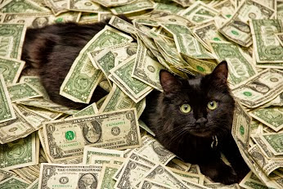
Finance
The Queen's personal fortune has been the subject of numerous speculations for many years. Sometimes its value is estimated at even 10 billion dollars. Forbes magazine usually sets the queen's estate for about 500 million dollars (280 million pounds). EuroBusines valued Queen Elizabeth's estate for 450 million euros in 1999. The queen also has many estates of undetermined value (Sandringham House, Balmoral, Mey Castle). It is speculated that the queen's income from these goods is about 70 million pounds. The Queen Elizabeth II also has crown property worth 6 billion pounds.

Slide 6
Role in government
Constitutionally, the queen is an important element of the British system of power, but its role is de facto symbolic. As constitutionalist Walter Bagehot stated, the queen has only the right to advise, encourage and warn.

Slide 7
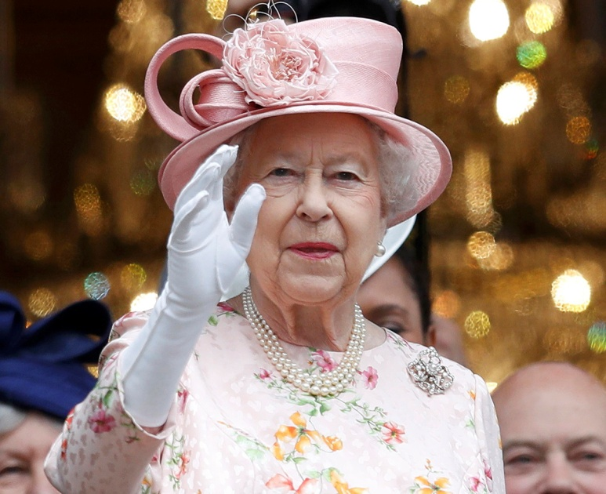
Personality and image
The Queen Elizabeth II rarely gives interviews, and her views are known only to a few heads of government.
Shee dresses traditionally and tastefully.
She participates in many cultural events. She is interested in horse riding, photography and dogs.

Slide 8
The Queen in the media
Elizabeth II was the first person who let the media into the life of the royal family.
In 1953, contrary to Churchill's advice, she agreed to broadcast the coronation and painted her lips blue so that the TV screen would look red. She first appeared live on television in 1959, when she opened a ferry line on the Saint river. Lawrence.
From 1969, he regularly sends Christmas cards to Commonwealth countries.
Since 2001, the pages are officially available on the website of the monarchy.

Slide 9
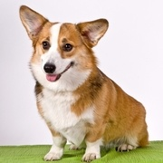
Curiosities
The Corgi is the beloved dog breed; however, she also grows Labradors Retrievers and Spaniels. All dogs of Queen Elizabeth II were personally trained and trained by her
The queen herself has the reputation of an outstanding trainer and active dog lover. Currently, Elizabeth II, has about 25 dogs in her private breeding. Among them, there are 5 Spaniels: Bisto, Oxo, Flash, Spick and Span.

Slide 10
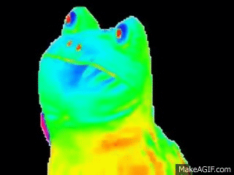
Made by…
Cezary Rajba
Piotr Rudy ( ͡° ͜ʖ ͡°)

