Slide 1
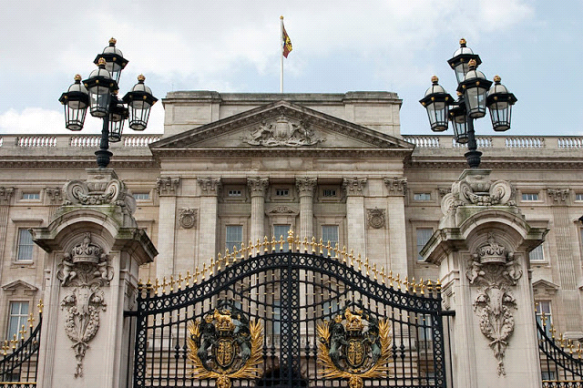
Queen’s Homes
Przygotowali:
Helena Myszewska
Robert Markowski-Przeliorz

Slide 2
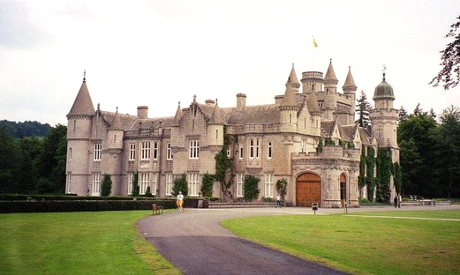
Buckingham Palace was built in 1703 for the Duke of Buckingham. For many years it was expanded and transformed. The current form was given in 1913. This palace is the official London seat of the British monarchs from 1837. It is here that the largest state celebrations and official meetings with the Queen take place, which is visited annually by around 50,000 people. This building is one of the most famous and largest in the world. It has about 77 thousand square meters of living space.
Buckingham Palace

Slide 3
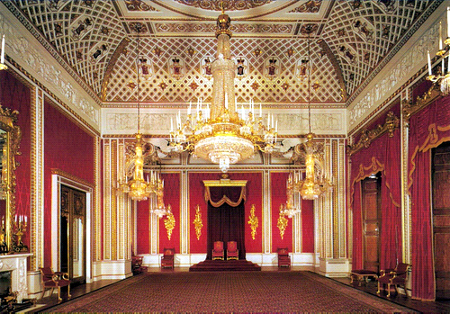
It is here that the largest state celebrations and official meetings with the Queen take place, which is visited annually by around 50,000 people. This building is one of the most famous and largest in the world. It has about 77 thousand square meters of living space.

Slide 4
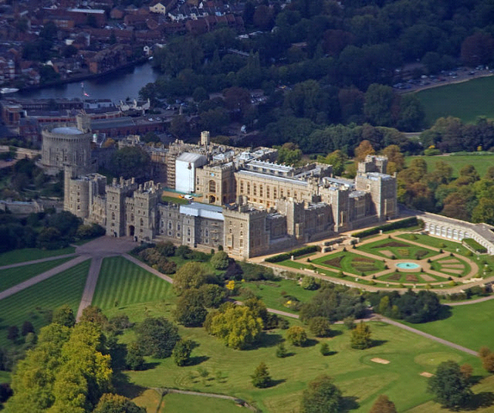
Windsor Castle has over 1000 years of history. It is the largest and oldest inhabited castle in the world. It is located on 5 hectares of land, and the living area is 45 thousand meters. On its site there are many important and famous places such as:
1. Round Tower
2. Horseshoe Convent
3. The Norman Gate
4. The Tower of Edward III
5. King Henry VIII
6. Chapel of St. George
Windsor Castle

Slide 5
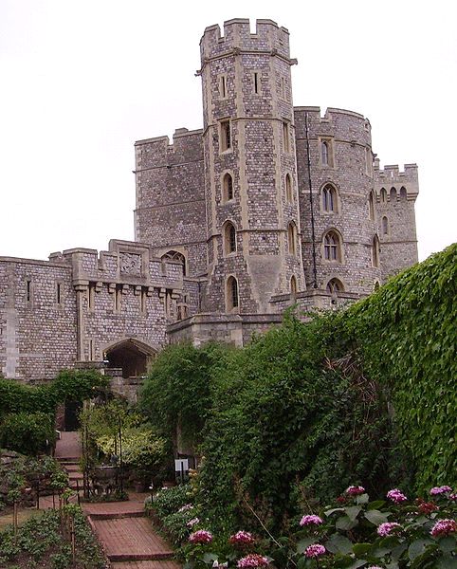
Round Tower in Windsor Castle

Slide 6
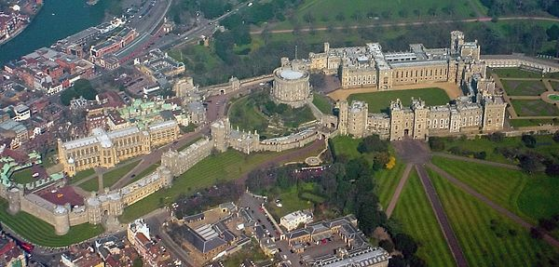
The castle currently has many valuable collections of paintings, drawings and handicrafts. Unfortunately, a fire broke out in 1992, which caused huge losses. Its reconstruction lasted for 5 years. At present Queen Elizabeth spends many weekends here, accepting both official and private guests. Also in this castle takes place the highest civilian and military badge of Great Britain, that is the Order of the Garter.

Slide 7
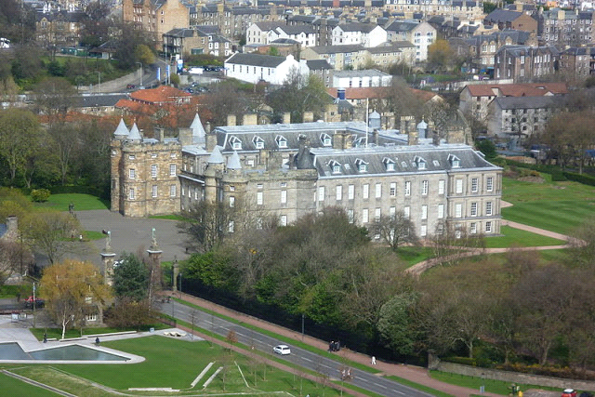
Holyrood Palace is located in Scotland in Edinburgh. And it is the residence of the British monarchs. It was built in 1498 and its present appearance is the result of the reconstruction carried out in the 17th century. The palace is the place of many state ceremonies and official receptions. The interiors are decorated with beautiful paintings, portraits and tapestries.
Holyrood Palace

Slide 8
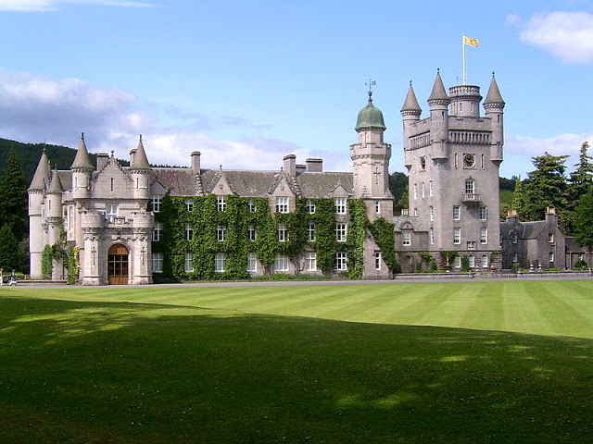
Balmoral Castle is one of the most beautiful castles in Europe. Located in Scotland, surrounded by a 20,000 hectare estate, by the River Dee. It was built in the fourteenth century, and the current appearance is the result of the reconstruction in the nineteenth century. It is now the private summer residence of the queen, who apparently loves this castle. Every year, numerous events take place here. Near the castle (about 1.5 km) is Craigowan Lodge. It is a quartermaster with seven bedrooms, in which the queen spends her first days of summer vacation.
Balmoral Castle

Slide 9
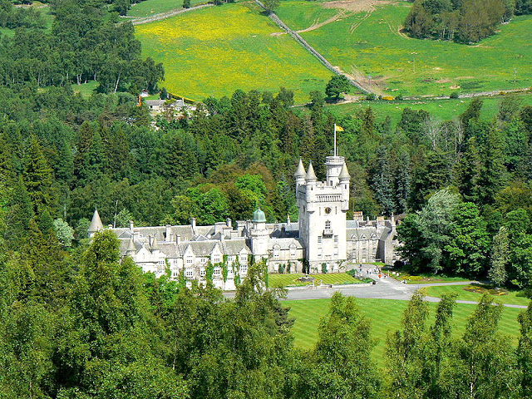
Here, too, was the home of Prince Charles and Princess Diana, when they visited the Balmoral castle. Another location close to the castle is Delnadamph Lodge. It is a residence donated by Queen Elizabeth to Prince Charles and Princess Diana on the occasion of their wedding. Unfortunately, it has been rarely used and not renovated for many years. At the moment, work is underway to renovate it. Upon completion, the house will be made available to the Duke of Wales and the Duchess of Cornwall.

Slide 10
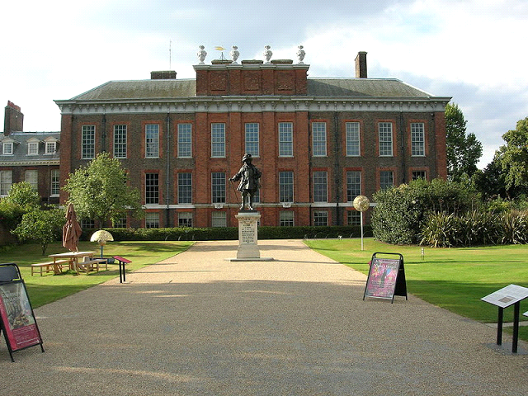
The Kensington Palace has been a royal residence in London since the 17th century. Above all, it plays the role of an apartment building for the monarch's family. In 1981, Prince Karol and Princess Diana lived after the wedding. It was also here that Princess Margaret had her home until 2002. Today, the main residents are Princess Kate and Prince William. The prince's couple Gloucester and Prince Michael from Kent with their wife also have their official apartment here. The property is home to Wren House, which is the home of Prince and Princess of Kent. In 2013, Prince Harry entered the Kensington Palace by choosing Nottingham Cottage for his new home.
Kensington Palace

Slide 11
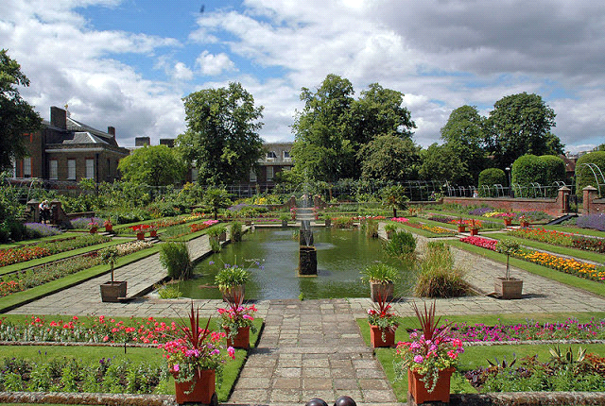
The most interesting places in Kensington are the King's Gallery, a collection of royal costumes from the previous three centuries, and the King's Staircase, stairs depicting scenes from the life of George I at the court. Of course, you can not miss the wonderful gardens.

Slide 12
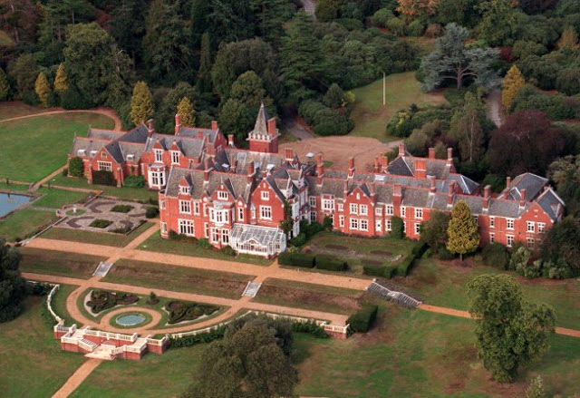
Bagshot Park is a royal residence in Sorrey County, and its name was taken from the village of Bagshot near the property. Originally a permanent residence built in 1633 at the request of Charles I Stuart. However, in 1878 the building was demolished, and in its place a year later a new building was created, which in the 90s of the twentieth century underwent a thorough renovation. Currently, it is the official residence of Prince Edward and his family.
Residence of Bagshot Park

Slide 13
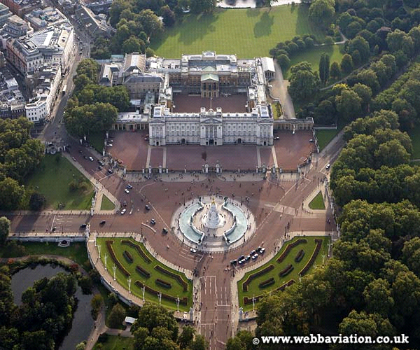
This is just the 6 mansion of Queen Elizabeth II and her family. There are many more ...

Slide 14
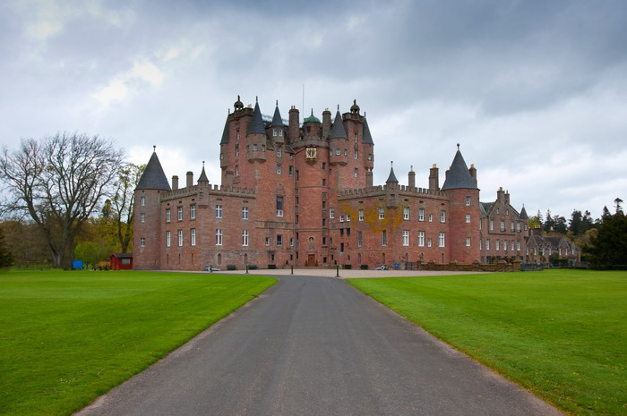
Thank you for your attention!
Presiding prepared by:
-Helena Myszewska
-Robert Markowski-Przeliorz

