Slide 1
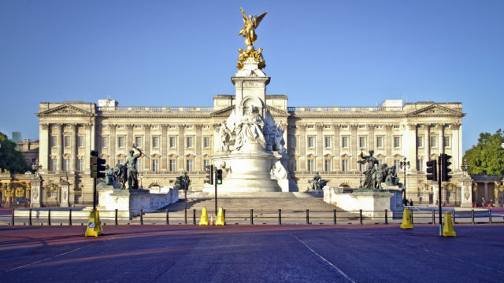
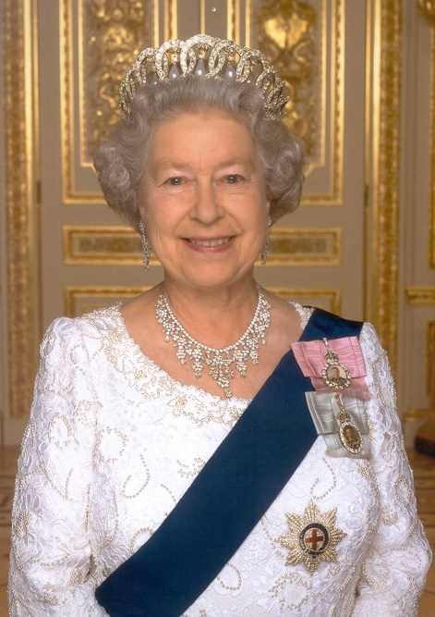
The Queen Elizabeth II

Slide 2
Buckingham Palace
Buckingham Palace located in London was built in 1703
Buckingham Palace has 77 thousand square meters of living space.
It contains 19 representative halls, 52 sleeping rooms, 78 bathrooms, 188 rooms for service and 92 offices.

Slide 3
Flag
One of the most important elements of the Palace is the flag. When it is up means that the Queen is at home and when it is down it means the Queen is out.

Slide 4
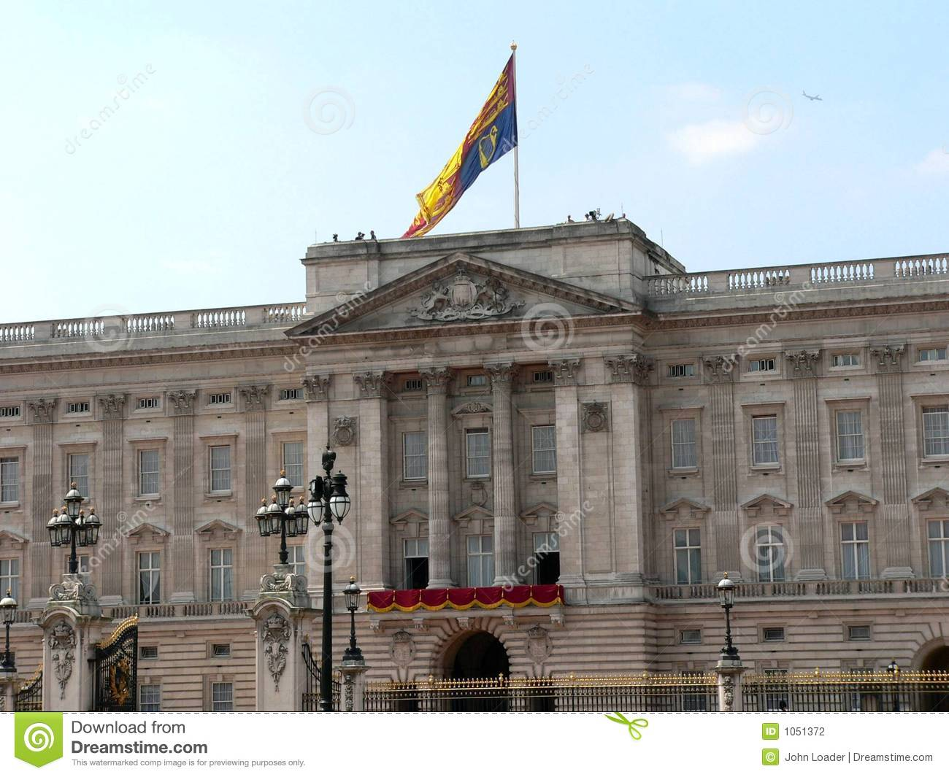

Slide 5
Curiosities
The Change of the Quard takes place every summer day.
The pedestrian and horse troops of the Royal Quard present themselves proudly, and their clothing and hats ("bearskins") weigh 665 grams and are often passed from the father to the son in families. The whole ceremony takes about 30 minutes.

Slide 7
The Palace is the largest in the world.
The Palace stands in its place from 1705, but its history goes back to earlier times. King Henry VIII, who organized hunting there, also liked this place.

Slide 8
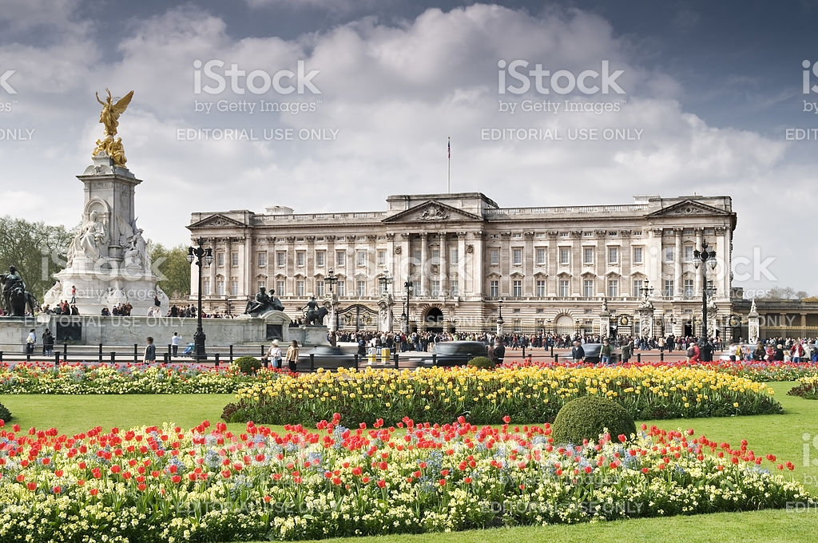
Garden
Here is the Buckingham garden:

Slide 9
Arms

Slide 10
Since 1992, tourists can see some of the representative rooms in the Palace.
In front of the Palace there is a monument to its predecessor - Queen Victoria. The sculpture made of white marble was created by Thomas Brock in 1931.

Slide 11
Since the fire at the Royal Castle in Windsor in 1992, part of the Buckingham Palace is available to visitors for a fee.
In August and September, during the Queen's holidays, you can visit the Buckingham apartments. The ticket costs about 20 pounds.

Slide 12
THE END
Jagoda Biś i Klaudia Gurbiel

