Slide 1
The Royal Family
Przygotowały:
Julia Kulawik
Paulina Zynek

Slide 2
The Queen’s birth
Elizabeth II was born on 21 April 1926, at 17 Bruton Street in London.
Her full name is Elizabeth Alexandra Mary.
Her family name is Windsor.

Slide 3
The Queen’s father was Albert.
Albert was Duke of York. He was the second son of King George V, and he changed his name to George when he became King in 1936.

Slide 4
The Queen’s mother was Lady Elizabeth Bowes-Lyon.
Her family owned an ancient castle in Scotland called Glamis which is famous for its ghosts.

Slide 5
The Queen’s sister
Princess Margaret Rose was born when Queen was 4 years old.

Slide 6
The Queen’s marriage
Elizabeth married her cousin, Prince Philip of Greece.
Their wedding ceremony was a very happy event after the long sad years of the war.

Slide 7
The Queen’s son
In 1948 Elizabeth had a first son, Charles ( now Prince of Wales ).
He will became king after Queen.

Slide 8
The Queen’s daughter
Princess Anne was born in 1950 (now Princess Royal ).

Slide 9
The youngest sons of Queen
Prince Andrew ( 1960 )
Prince Edward ( 1964 )

Slide 10
About Charles, Prince of Wales
The first wife of Prince Charles was Lady Diana Frances Spencer ( Princess of Wales ).
Their wedding ceremony was in 1981.
Diana died in a car accident in Paris in 1997.

Slide 11
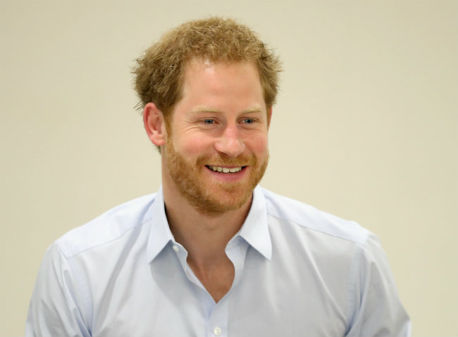
Their sons
William, Duke of Cambridge (1982)
Harry of Wales (1984)

Slide 12
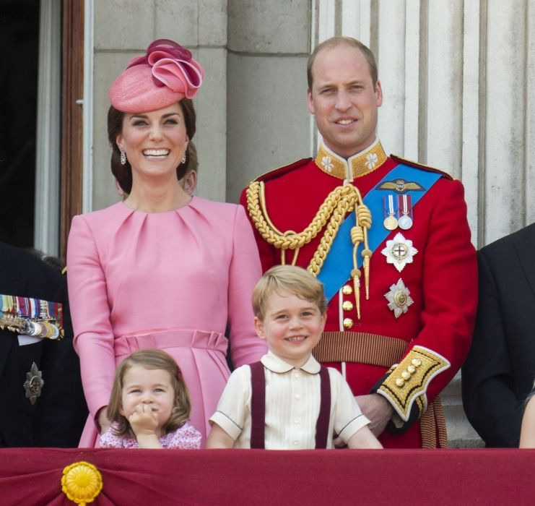
Prince William, The Duke of Cambridge
Prince William is the second in line to the throne.
His Royal Highness is married to The Duchess of Cambridge, Catherine, they have two children, Prince George and Princess Charlotte.
They are expecting their third child.

Slide 13
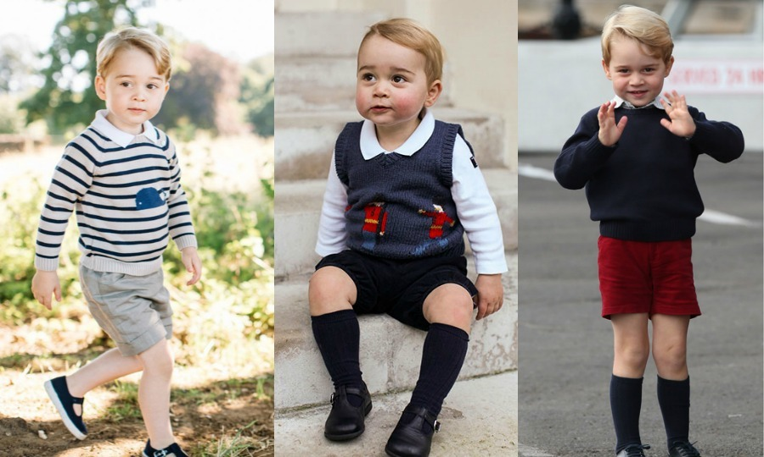
Prince George of Cambridge (2013)
Prince George
As the first child of The Duke and Duchess of Cambridge he is third in line to the throne, and the news of his birth was celebrated all around the world.

Slide 14
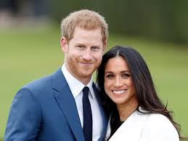
Prince Harry
Prince Harry and his fiancee.
The Prince of Wales is engaged to Meghan Markle.
The wedding will take place in spring 2018.

Slide 15
More about Prince of Wales
Camilla, Duches of Cornwall is the second wife of Prince Charles
since 2005.

Slide 16
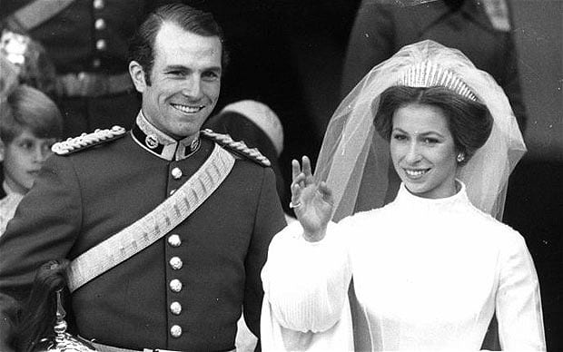
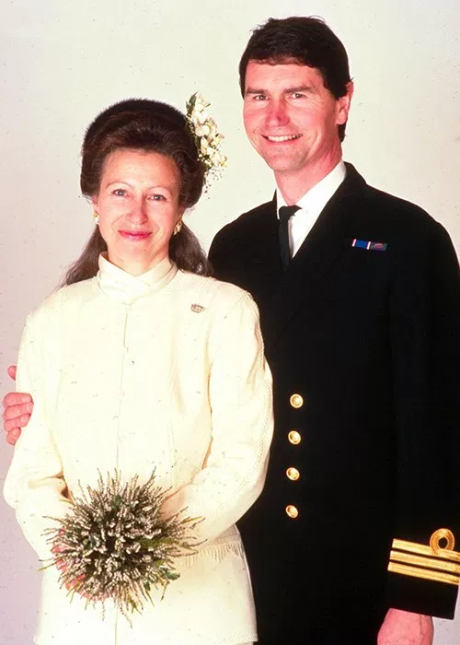
About Anna, Princess of Royal
Her first husband was Mark Phillips
Her second husband is Timothy Laurence

Slide 17
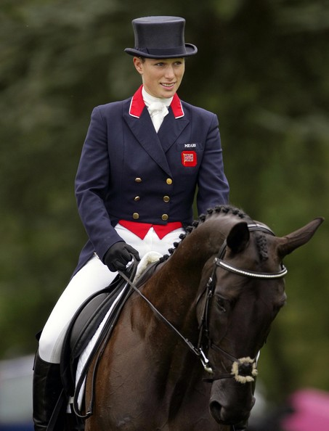
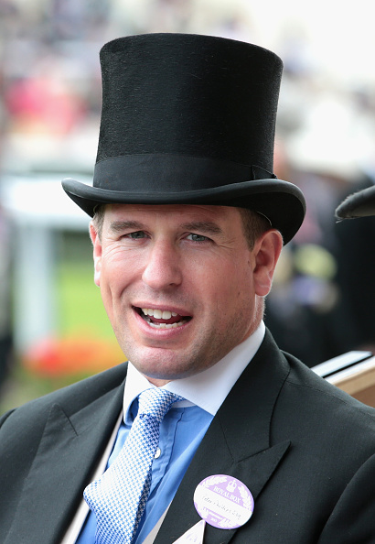
Children of Princess Anna and Mark Phillips.
Zara Phillips (1981)
Peter Phillips (1977)

Slide 18
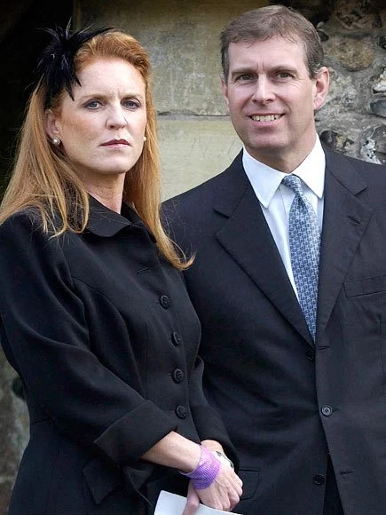
About Prince Andrew, Duke of York
In 1986 Andrew got married with Sarah Ferguson.
They devorced in 1996.

Slide 19
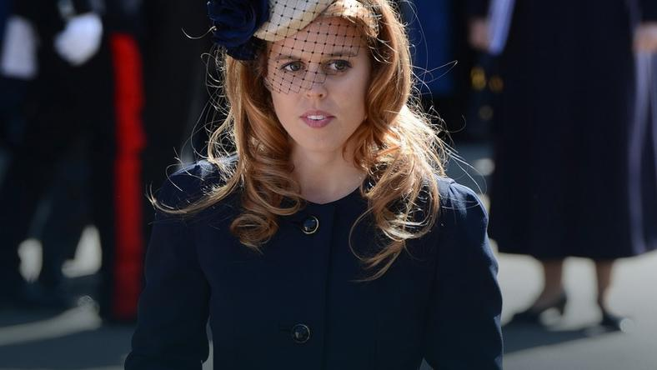
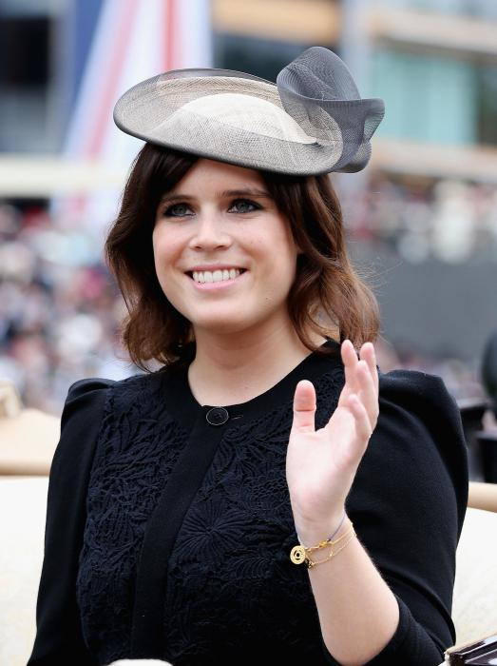
About their children
Beatrice (1988)
Eugenie (1990)

Slide 20
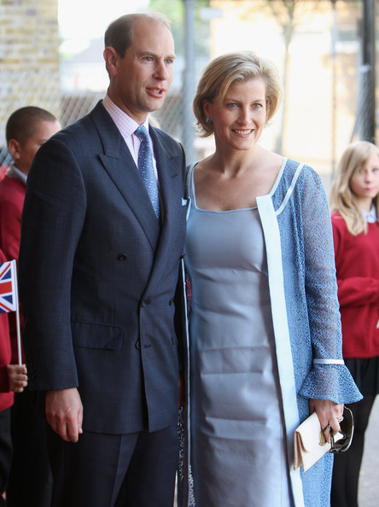
Aboat Edward, The Earl of Wessex
In 1999 he married Sophie Rhys-Jones

Slide 21
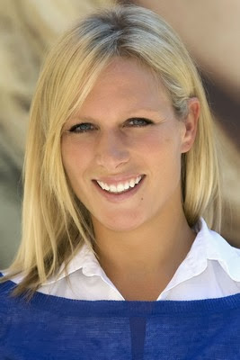
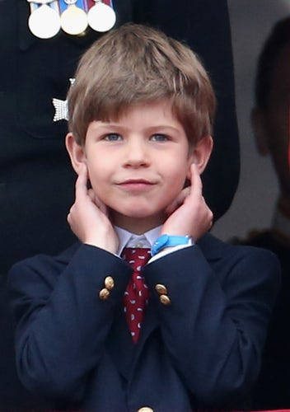
About their children
Louise Windsor (2003)
Jacob Windsor (2007)

Slide 22
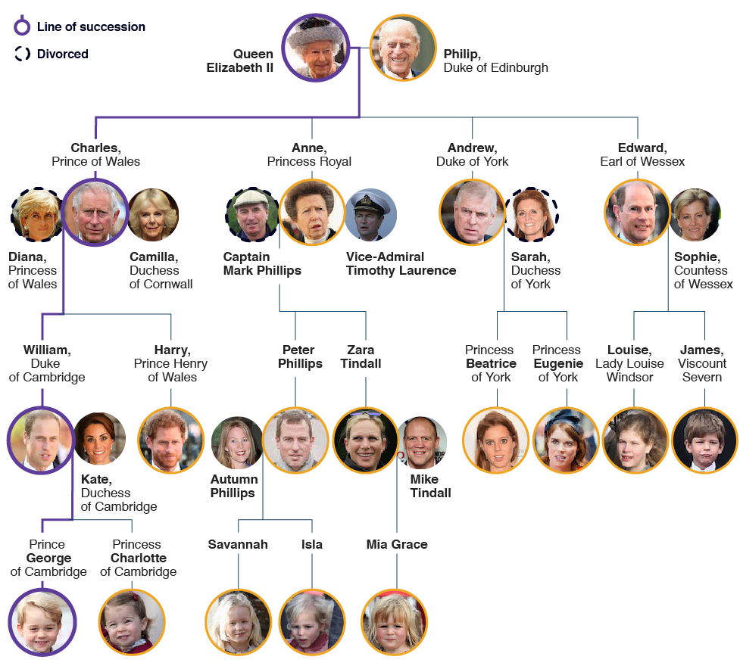
Royal Family

Slide 23
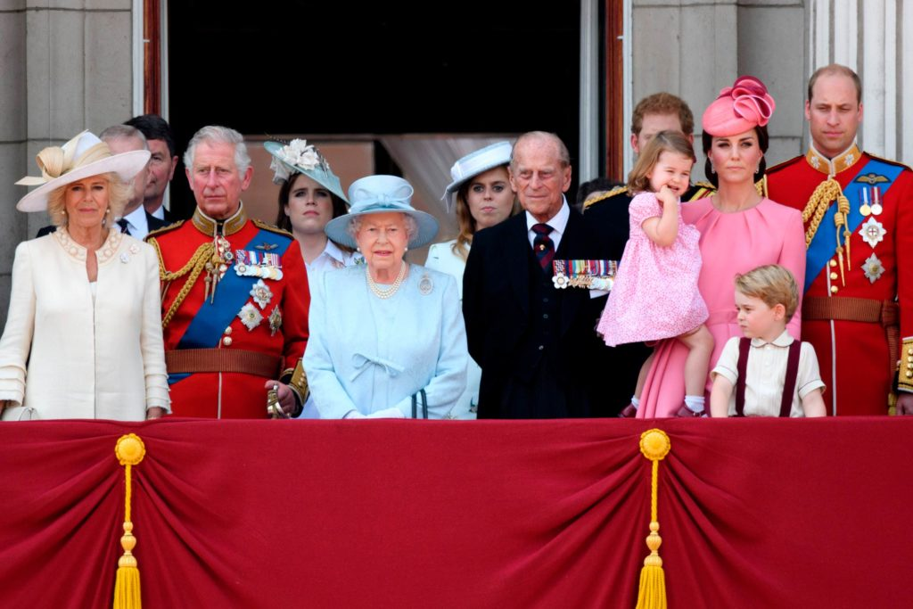
Royal Family

