Slide 1
Queen Elizabeth II
Julita Majewska

Slide 2
Elizabeth Alexandra Mary
Born April 21, 1926 –
Mayfair, London
The future queen was a serious, organized and systematic child.

Slide 3
1945- princess as a second lieutenant
In 1939, the Second World War broke out.
In early 1945, Elizabeth joined the Women's Auxiliary Territorial Service with the degree of Second Subaltern.

Slide 4
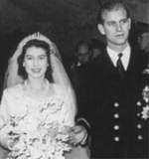
20 november 1947 Elizabeth's wedding with philip
On July 22, 1939,
the princess met her future husband.
The wedding took place on November 20, 1947 at the Westminster Abbey.

Slide 5
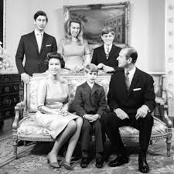
CHILDREN OF THE queen
On November 14, 1948, Elizabeth gave birth to her first child - Charles - Prince of Wales.
Soon after that, they come to the world:
Anna- born 15/08/1950
Andrew - born 19/02/1960
Edward - born on March 10, 1964.

Slide 6
CORONATION
Elizabeth II was proclaimed Queen
on February 7, 1952 in St. James's Palace.
The coronation took place in June 1953.

Slide 7
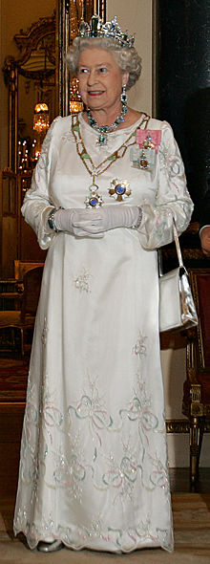
This year Elizabeth II ends 92 years and is the longest ruling queen.

Slide 8
Grandchildren and great-grandchildren
Elizabeth II has eight grandchildren and seven great-grandchildren.

Slide 9
Dziękuję za uwagę ☺

