Slide 1
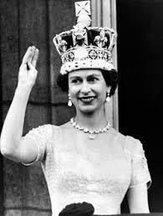
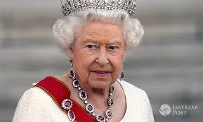
Elizabeth II Homes
Marcel Nowakowski,Oliwia główczyńska

Slide 2
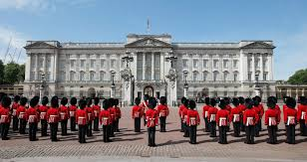
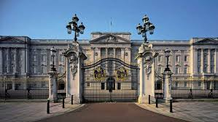
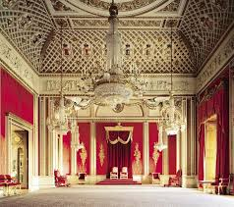
Buckingham palace
In this palace Queen Elizabeh II lives every day.
When you are in London between April and July, you can watch changing of the guard.
Can you see the flag? When the flag is up, Queen Elizabeth II is in palace, but when the flag is down - the Queen is not here.

Slide 3
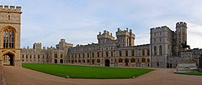
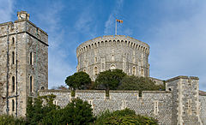
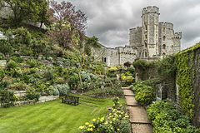
Windsor Castle
This castle is the favorite castle of Elizabeth II. In 1992 a fire broke out in the windsor castle . We don’t know what caused it. In our opinion this is the most beautiful castle of Queen Elizabeth.

Slide 4
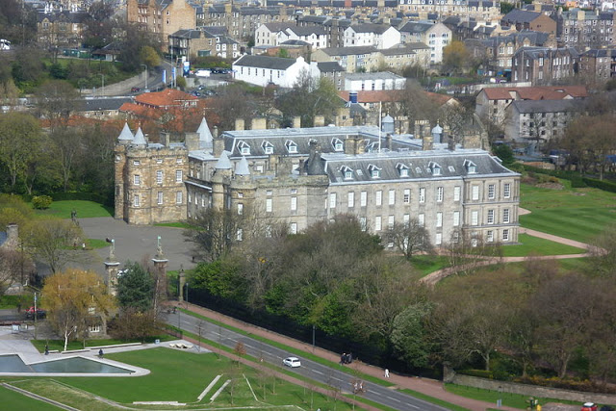
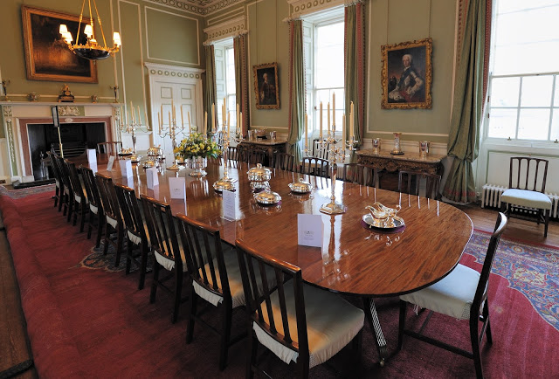
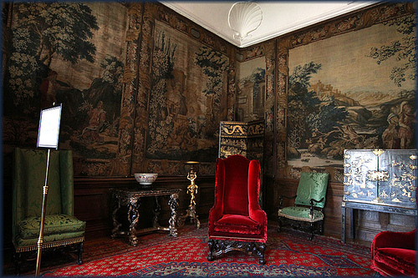
Holyroodhouse palace
This palace is in Edinburgh (Scotland). The palace was build in 1498, but its present appearance is the result of rebulding in XVII century.

Slide 5
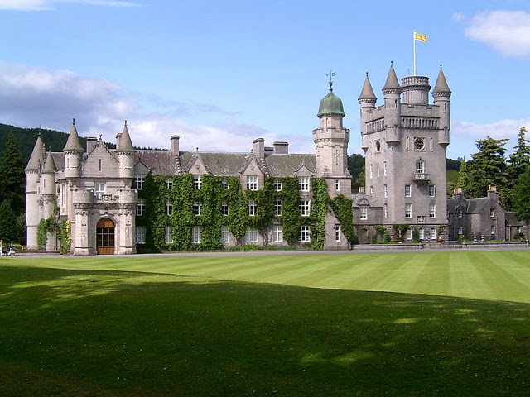
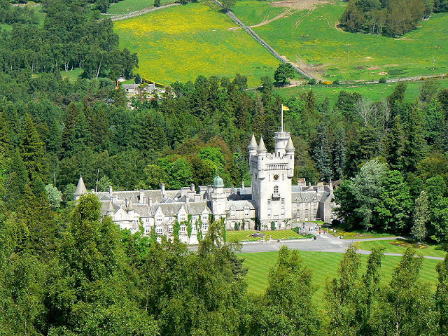
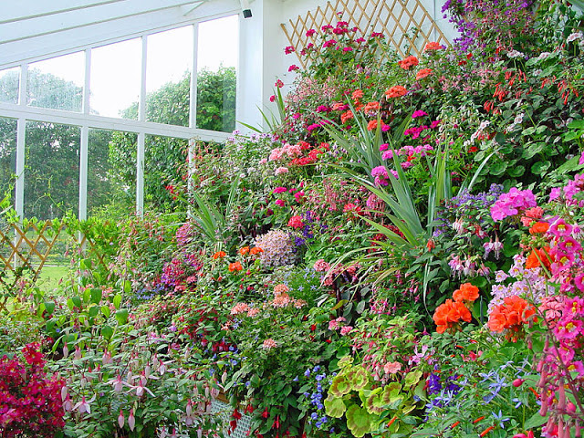
Balmoral castle
This is a private summer residence of Queen Elizabeth II. Every year there are held a lot of party.

Slide 6
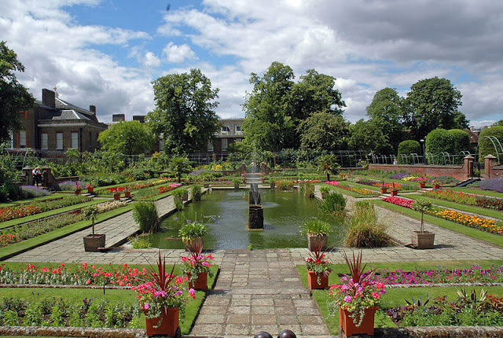
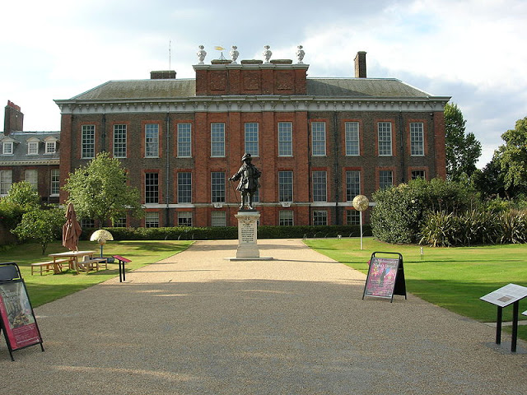
Kensington palace
In this palace Prince Wiliam and Princess Kate live there. Garden in this palace is the most beautiful garden that we have never seen!

Slide 7
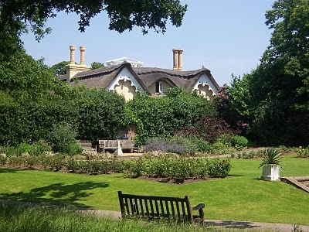
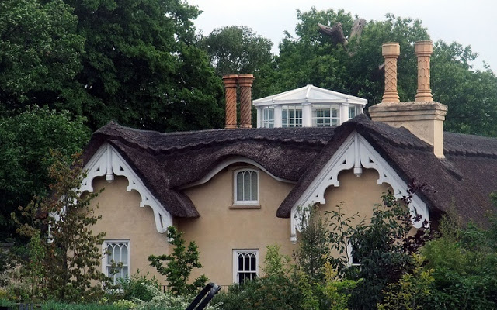
Thatched House Lodge
Thatched House Lodge is a royal residence located in London. It was built in 1673 and less than 100 years later it was given its present appearance. It is a very characteristic building due to the fact that it is thatched, hence its name.

Slide 8
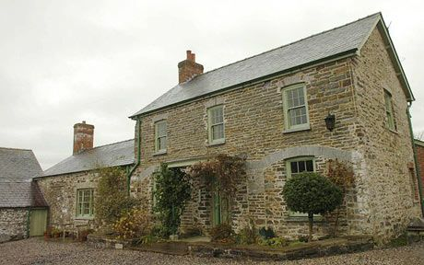
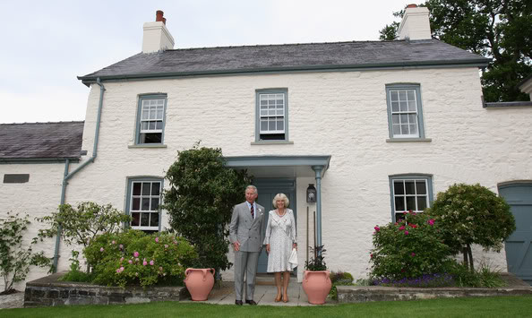
Llwynywormwood
From 2007 is a private residence of prince Charles and princess Kamila. two cottages next to the main residence can be rented while the prince is absent.

Slide 9
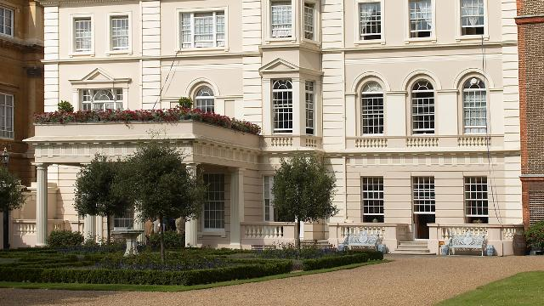
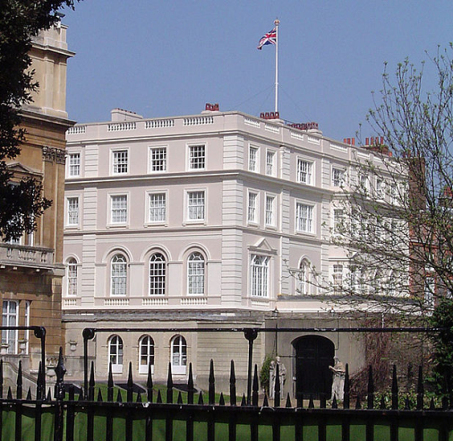
Clarence House
This castle is very special. During the World War II it served as a hospital. Now in this castle prince Charles lives with his family.

Slide 10
The end
this is only half of the locks that the queen has, not to prolong, we chose the most interesting ones

