Slide 1
The Queen’s homes

Slide 2
Buckingham Pa;ace
Palace buckingham is Queen’s favourite palace .
It is in London. Buckingham Palace has 775 rooms. These include 19 state rooms, 52 Royal and guest bedrooms, 188 staff bedrooms, 92 offices and 78 bathrooms . Since 1992 tourists can go to palace ( but only when Queen is out )
More than 50,000 people visit the Palace each year !
The building is 108 metres long and 24 metres high .

Slide 3
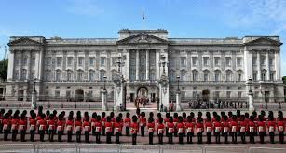
palace buckingham

Slide 4
Windsor castle
.
Windsor castle was built 1070 - 1086 by Jeffry Wyatville . The building is england residence.
Windsor castle has 1 milion tourists per year.
Windsor castle is 2nd Queen favourite castle .

Slide 5
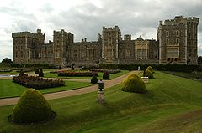
Windsor castle

Slide 6
Clarence House
Clarence House was built in 1825-1827 by John Nash for prince Clarence .
Clarence house is a residence .
It is familiar to house but its bigger

Slide 7
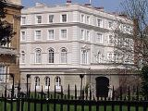
Clarence house

Slide 8
Made by Tomasz Łaskawiec
Thanks for watching !

