Slide 1
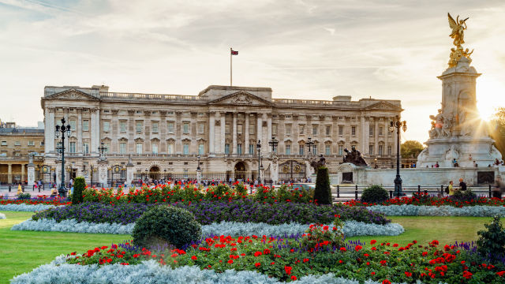
The Queen’s Homes

Slide 2
Buckingham Palace
The palace was built in 1703 as a town residence for the Duke of Buckingham, John Sheffield.

Slide 3
Rooms and conscrution
Buckingham has 77 thousand square meters of living space. It contains 19 representative halls, 52 sleeping rooms, 78 bathrooms, 188 rooms for service and 92 offices.
Other members of the royal family also live there. And they lived there even in times of danger, during both wars.
Tourists can see paintings by Rembrandt, Rubens, Poussin, Canaletto and many more.

Slide 4
Attractions
An interesting attraction and still the most popular reason for visits to the palace is the ceremonial change of the guard, which takes place from April to July every day at 11:30, and in the remaining months - every other day.

Slide 5
Changing of the guards!

Slide 6
Crest

Slide 7
Flag

Slide 8
Trivia about the flag
The presence of the queen is evidenced by the banner hung at full height.

Slide 9
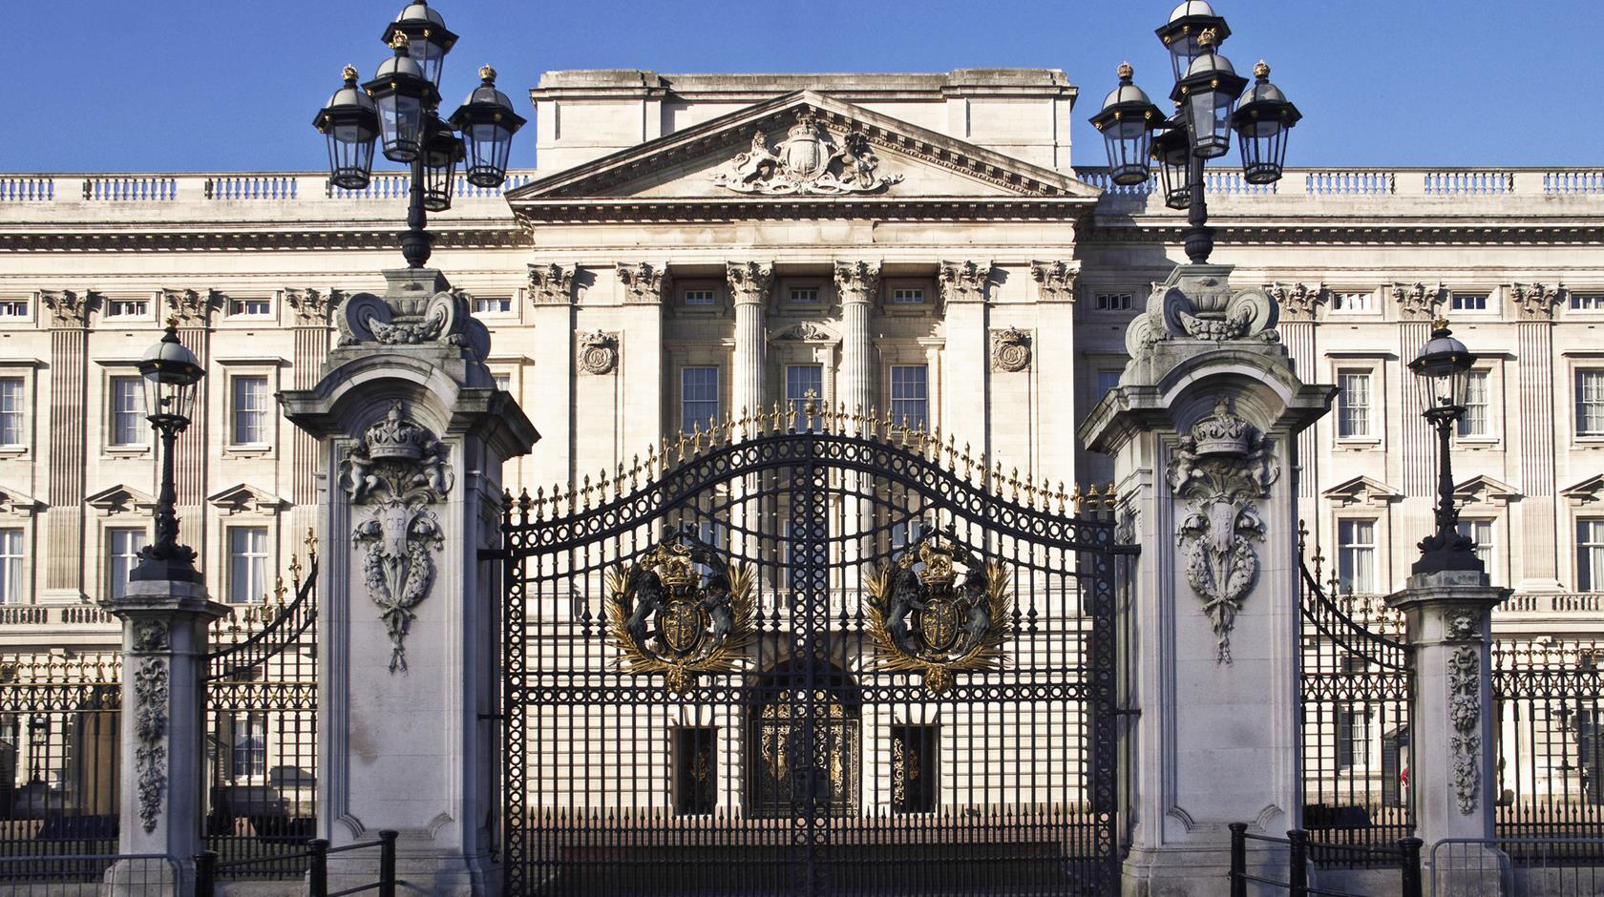

Slide 10
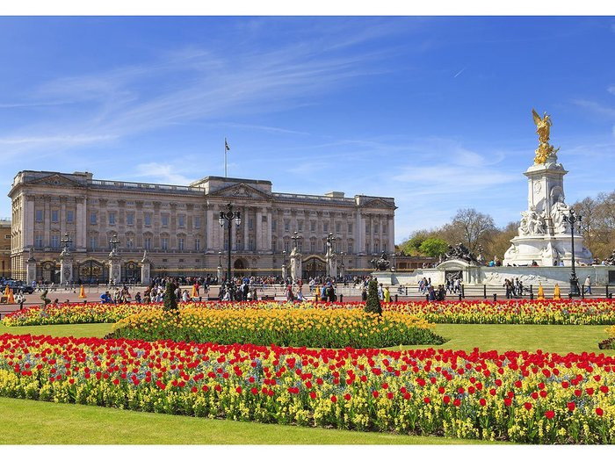
Buckingham garden
This is the Buckingham garden!

Slide 11
Stable of the Queen Elizabeth II!

Slide 12
Stable
Queen Elizabeth II is a great lover of horses.
For a queen, horseback riding is natural - she learned it right after she began to walk. Her first horse was the Shetland pony, which she named Peggy. It was a gift from her grandfather, King George V, on the occasion of the fifth birthday.

Slide 13
Dogs of Queen Elizabeth II

Slide 14
The Queen Elizabeth II dogs!
The Corgi is a beloved dog breed!
Queen Elizabeth II created her own dog rase.
Queen Elizabeth II has her own private kennel.

Slide 15
The fire at Windsor Palace!
From the Palace, immediately after the fire was discovered, all service was evacuated. Thanks to that no one was injured. This is the first evacuation of the Palace since the end of World War II.
For the time being, it was not determined what caused the fire. Loss was also not estimated.

Slide 16
Fire at Windsor Palace!

Slide 17
Thank you for your attention!♥
Pracę wykonywały:
Wiktoria Gurbiel i Róża Biś

