Slide 1
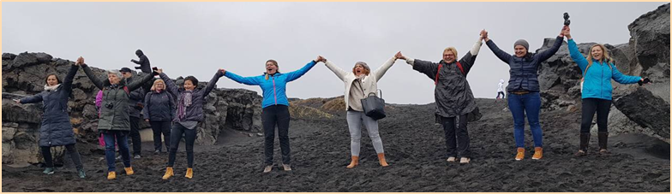



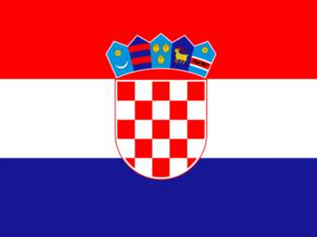

Our Iceland
handmade-headmade-homemade
Elina Krautman, Arijana Dobrila Barbaro, Henrieta Herjavec Rubcic, Zaklin Luksa, Ana Marinić, Samanta Matejcic Cotar, Marta Dziura
Estonia, Poland and Croatia

Slide 2
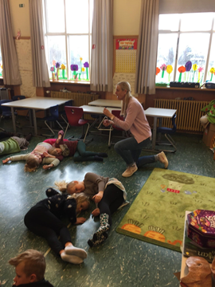
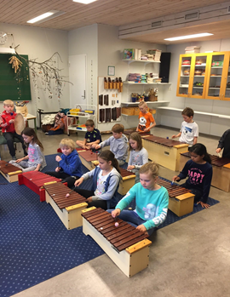
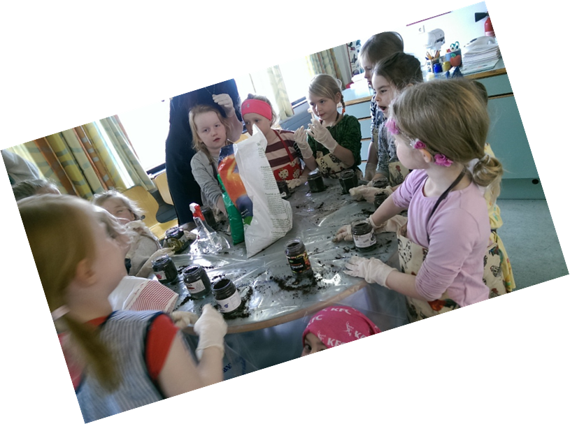
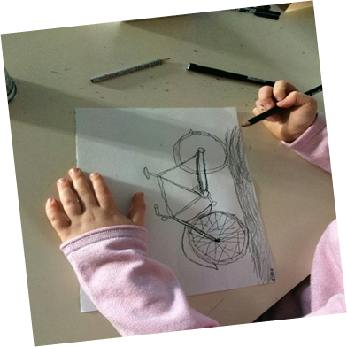
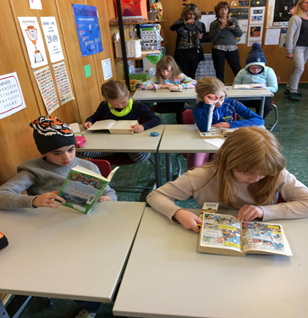
Learning about schools & Education
Literacy
Sustainability
Health and welfare
Democracy and human rights
Equality
Creativity

Slide 3
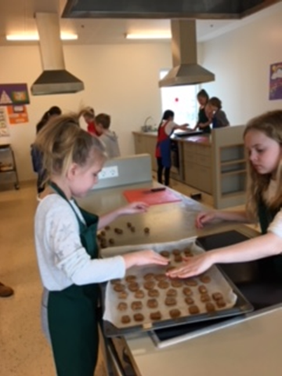
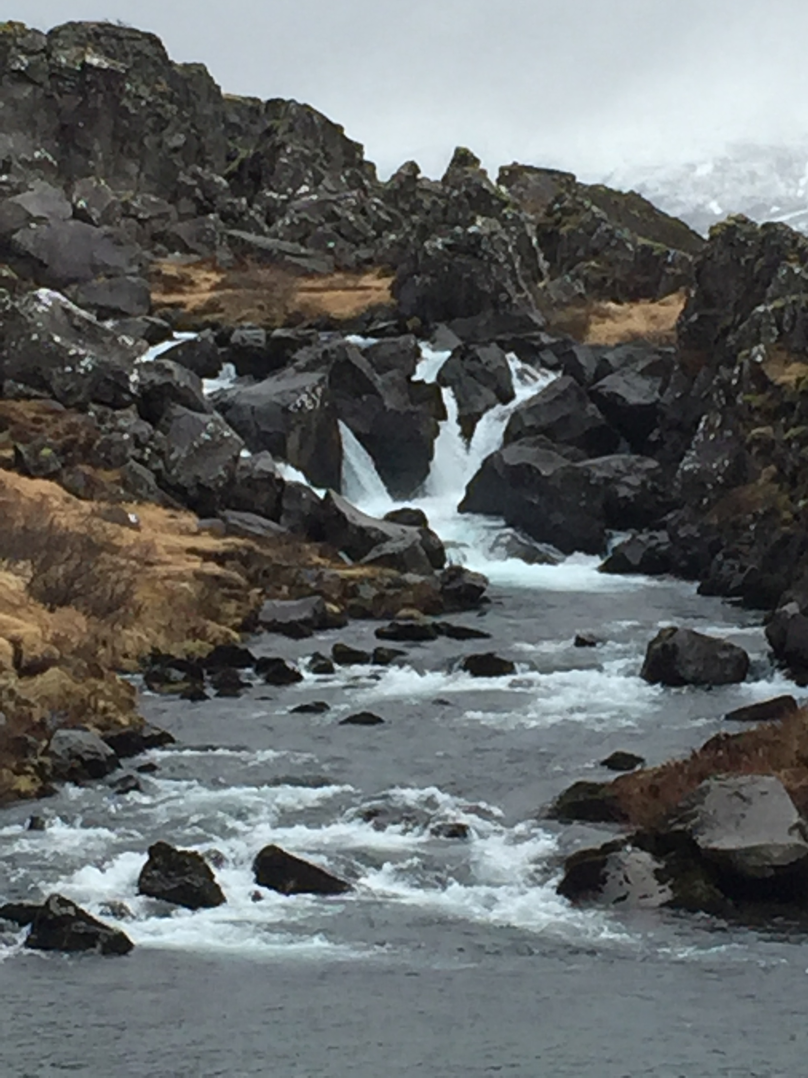
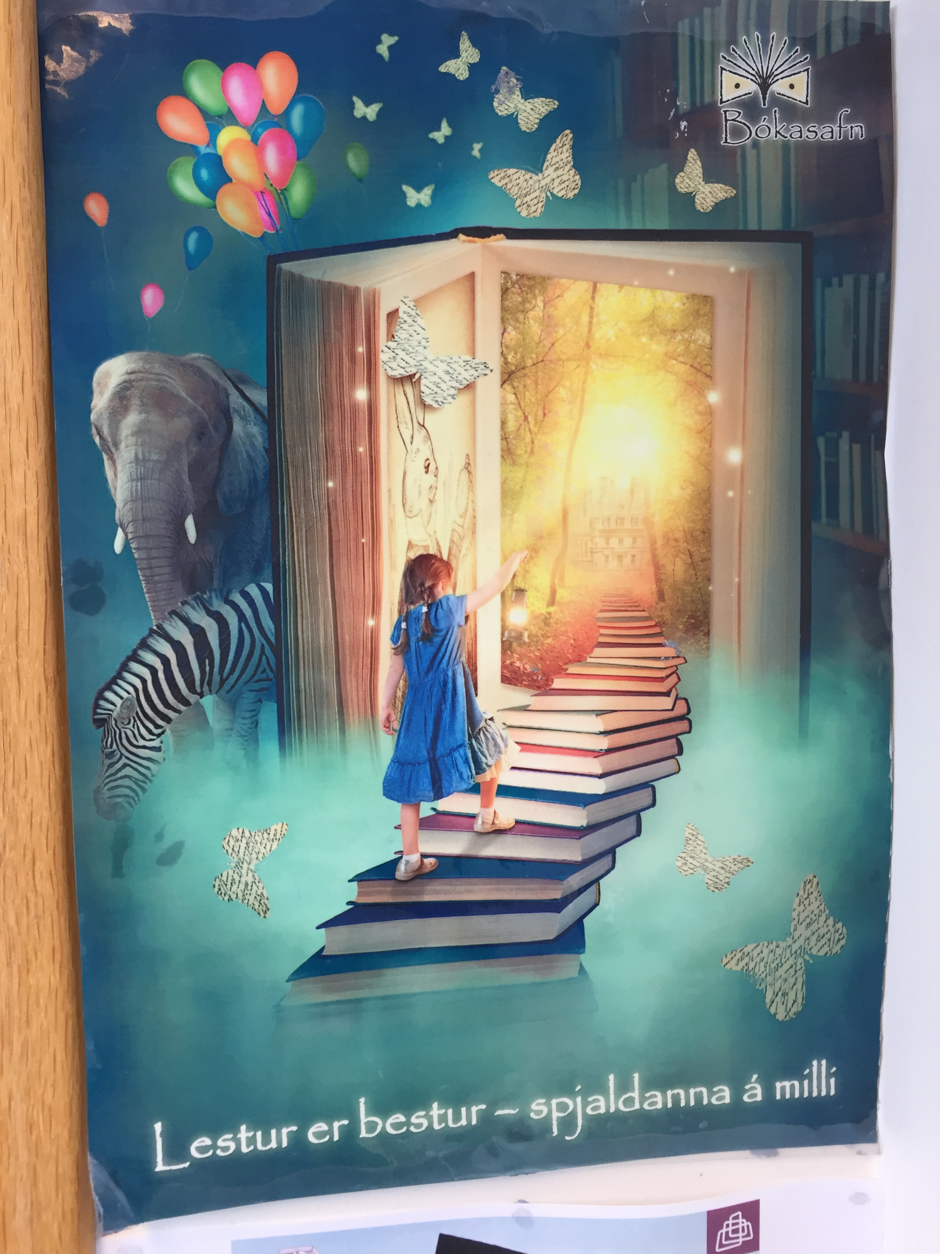
Most representative pictures of our experience

Slide 4
Implementation of activities
PRIMARY CLASS TEACHERS
MOTHER TONGUE-have a lesson starting with reading
MATH – learning through game
ART – using the natural environment as a trmplate for teaching
SCIENCE - take kids outdoor to learn from their own experience
HOME ECONOMIC - preparing traditional Icelandic food
PHYSICAL EDUCATION - spend more time outdoor no matter of weather forecast
PRINCIPLE
- advise teachers to go abroad to learn from their european colleagues
- pay attention to teach in a creative and interdisciplinary method rather than deal with administration job
- reorganize extracurricular activities in order to enhance student's practical skills

Slide 5
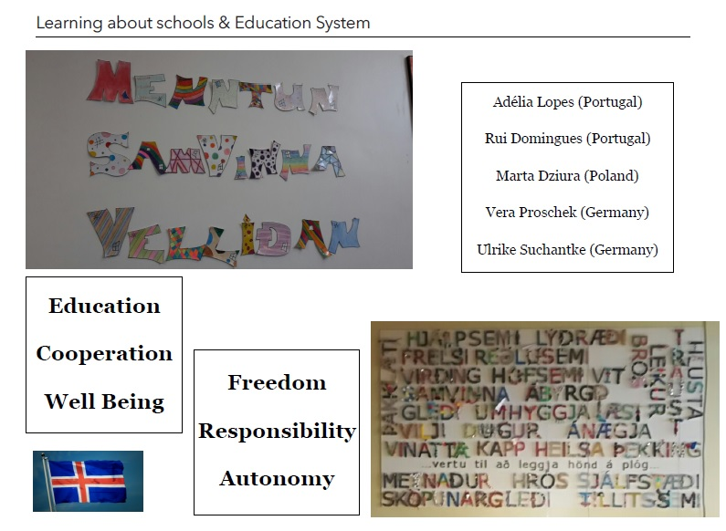

Slide 6
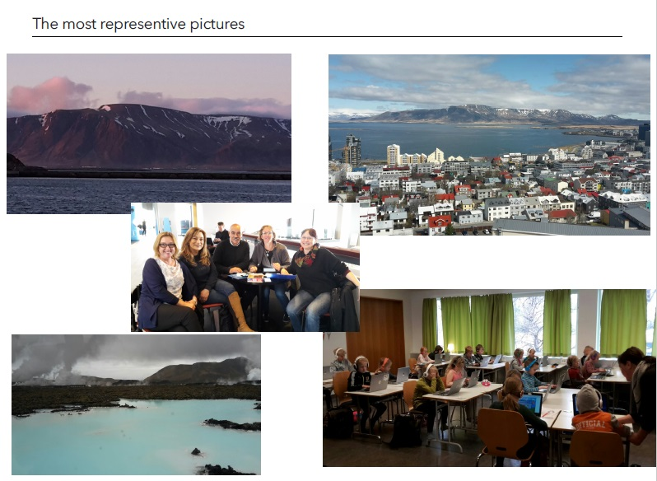

Slide 7
