Slide 1
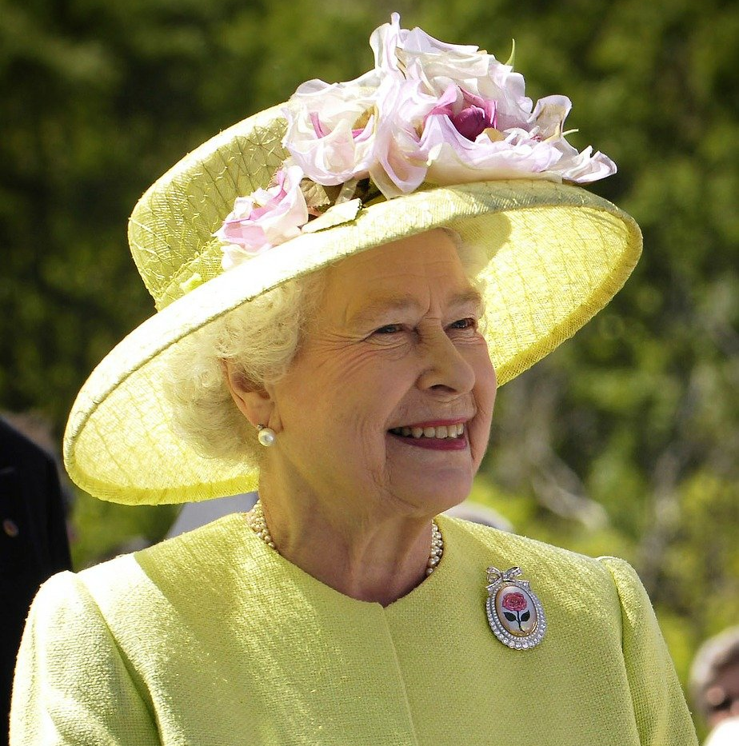
Queen
Elizabeth II

Slide 2
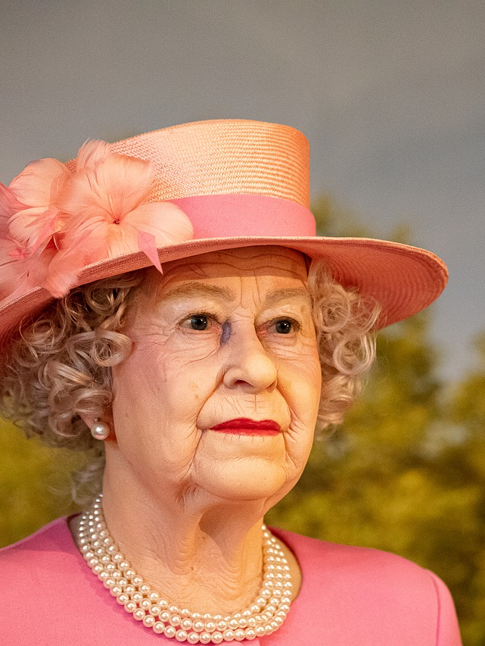
Elizabeth Alexandra Mary Windsor was born on 21 April 1926, during the reign of her paternal grandfather,
King George V.
Her father, the Duke of York was the second son of the King. Her mother, the Duchess of York.Elizabeth's only sibling, Princess Margaret, was born in 1930.
The two princesses were educated at home under the supervision of their mother and their governess.

Slide 3
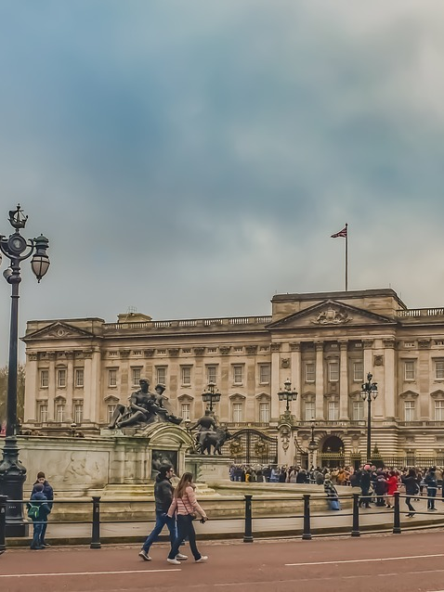
Elizabeth was born in Mayfair, London, as the first child
of the Duke and Duchess of York.
Her father ascended the throne on the abdication of his brother King Edward VII in 1936.

Slide 4
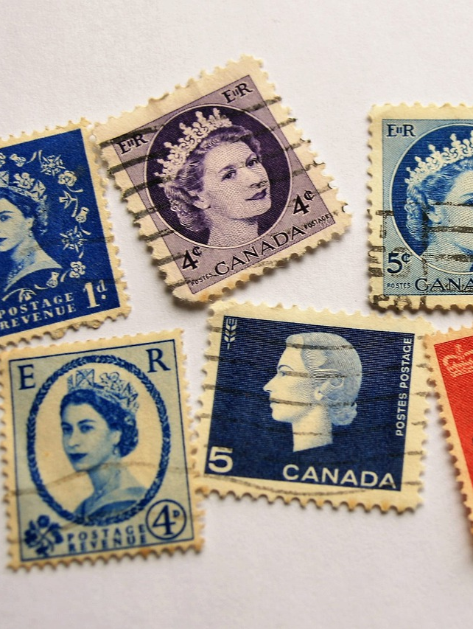
In 1947 she married Philip,Duke of Edinburgh,
a former prince of Greece and Denmark, with whom she has four children:
Charles, Prince of Wales, Anne, Princess Royal,
Prince Andrew, Duke of York and Prince Edward, Earl of Wessex.

Slide 5
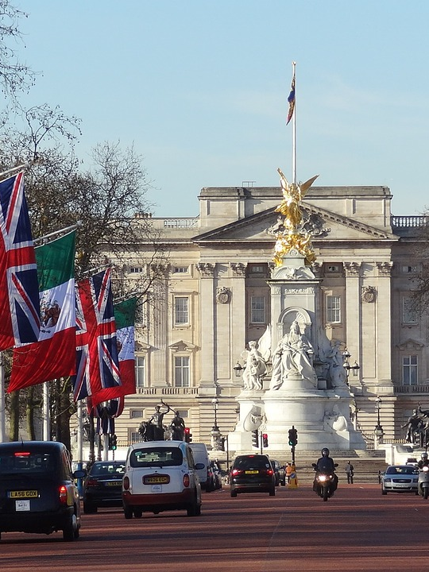
When her father died in February 1952, Elizabeth became head of the Commonwealth and queen regnant of seven independent Commonwealth countries: the United Kingdom, Canada, Australia, New Zealand, South Africa, Pakistan, and Ceylon.

Slide 6
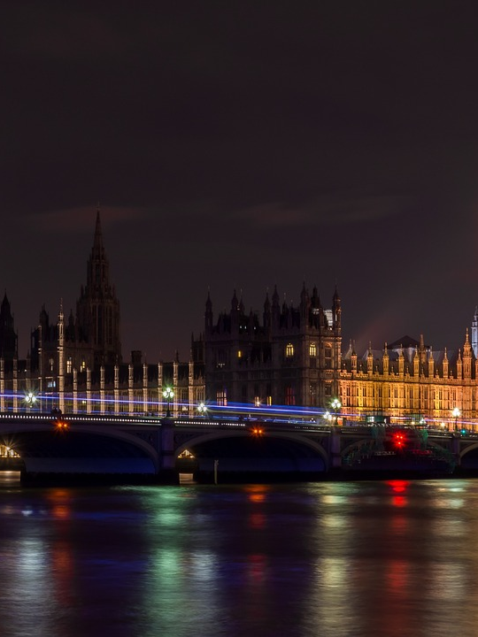
In 2017, she became the first British monarch to reach a Sapphire Jubilee. She is the longest-lived and longest-reigning British monarch. She is the longest-serving female head of state in world history, and the world's oldest living monarch, longest-reigning current monarch, and oldest and longest-serving current head of state.

